Slide 1
Employee Data Analysis Project Using SQL “Empowering decision-making through data insights” Name : Majevadiya Purvang Niteshbhai

Slide 2
Agenda
Project Overview
Dataset Description
Analysis Using SQL Queries

Slide 3
Project Overview
In this project, I conducted an in-depth analysis of employee data to address key business requirements across multiple departments. Using SQL, I processed and queried the data to provide actionable insights, such as hiring trends, salary distributions, and department-specific metrics. The analysis not only highlights my technical expertise in SQL but also demonstrates my ability to solve real-world business problems effectively.
Highlights:
Objective: To extract meaningful insights from employee data that cater to specific business queries.
Methodology: Leveraged SQL to perform tasks such as filtering, sorting, aggregating, and deriving actionable data.
Key Outcomes: Provided hiring insights, salary distributions, and department-wise employee statistics.
Tech Stack: SQL (with a focus on intermediate queries and optimization).

Slide 4
Dataset Description
A Dataset contains 10 Column Namely,
Employee_No
First_Name
Last_Name
Job_ID
Job_Title
Department_No
Department_Name
Hire_Date
Annual_Salary
Commision_Percent
Employee_No | First_Name | Last_Name | Job_ID | Job_Title | Department_No | Department_Name | Hire_Date | Annual_ Salary | Commission_Percent
101 | Ravi | Sharma | 20101 | Manager | 20 | Sales | 1987-09-16 | 12000.76 | 0
102 | Kapil | Shah | 200105 | Product Excutive | 50 | Marketing | 1996-05-12 | 15000.55 | 1
103 | Niharika | Soni | 200107 | Programmer | 10 | IT | 1988-06-11 | 17000 | 0
104 | Richa | Sharma | 200187 | Exceutive | 40 | Admin | 1994-08-17 | 55000 | 2
105 | Tejas | Patel | 200976 | Manager | 30 | HR | 1990-01-27 | 30000 | 0
106 | Kanika | Kapoor | 200765 | Accountant | 0 | Finance | 1992-05-21 | 33000.887 | 3
107 | Rohan | Seth | 200234 | Programmer | 10 | IT | 1989-11-13 | 26000 | 6
108 | Zainab | Kapasi | 200546 | Exceutive | 40 | Admin | 1989-11-12 | 20000.76 | 7
109 | Mittal | Bajaj | 200123 | Account Executive | 90 | Finance | 1992-06-21 | 10000 | 1
110 | Tina | Rai | 200548 | Support Assistant | 10 | IT | 1992-04-21 | 18000 | 2

Slide 5

Analysis Using SQL Accounting Department Requirements
Request 1
List the last name, first name and employee number of all programmers who were hired on or before 21 May 1991 sorted in ascending order of last name.
Query
SELECT EMPLOYEE_NO,FIRST_NAME,LAST_NAME FROM EMPLOYEE WHERE JOB_TITLE="Programmer" AND Hire_Date <="21-05-1991" ORDER BY LAST_NAME ASC;
Output

Slide 6
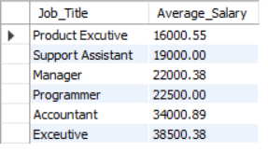
Request 2
List all the data for each job where the average salary is greater than 15000 sorted in descending order of the average salary.
Query
SELECT Job_Title, ROUND(avg(Annual_Salary),2) AS Average_Salary FROM EMPLOYEE GROUP BY Job_Title HAVING avg(Annual_Salary)>15000 ORDER BY avg(Annual_Salary);
Output

Slide 7
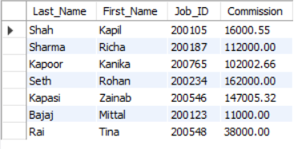
Request 3
List the last name, first name, job id and commission of employees who earn commission sorted in ascending order of first name. (Commision=Annual_Salary* Commission_Percent)
Query
SELECT Last_Name,First_Name,Job_ID,Round((Annual_Salary*Commission_Percent),2) AS Commission FROm EMPLOYEE WHERE Round((Annual_Salary*Commission_Percent),2) > 0
Output

Slide 8

Request 4
Which Job Title are found in the IT and Sales departments?
Query
SELECT Distinct(Job_Title),Department_Name FROM EMPLOYEE WHERE Department_Name="IT" OR Department_Name="Sales";
Output

Slide 9
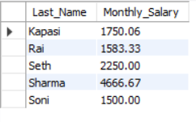
Request 5
List the last name of all employees in department no 10 and 40 together with their monthly salaries (rounded to 2 decimal places), sorted in ascending order of last name.
Query
SELECT Last_Name,Round((Annual_Salary/12),2) AS Monthly_Salary FROM EMPLOYEE WHERE Department_No=10 OR Department_No=40 ORDER BY Last_Name ASC;
Output

Slide 10
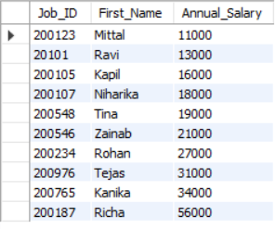
Request 6
Show the Annual Salary salaries displayed with no decimal places.
Query
SELECT Job_ID,First_Name,FLOOR(Annual_Salary) AS Annual_Salary FROM EMPLOYEE ORDER BY FLOOR(Annual_Salary);
Output

Slide 11

Personnel Department Requirements
Request 7
Show the total number of employees.
Query
SELECT COUNT(DISTINCT Job_ID) AS No_Of_Employee FROM EMPLOYEE;
Output

Slide 12

Request 8
List the department number, department name and the number of employees for each department that has more than 2 employees grouping by department number and department name.
Query
SELECT Department_No,Department_Name,Count(*) AS No_Of_Employee FROM EMPLOYEE GROUP BY Department_No,Department_Name HAVING Count(*)>=2;
Output

Slide 13

Request 9
List the department number, department name and the number of employees for the department that has the highest number of employees using appropriate grouping.
Query
SELECT Department_No,Department_Name,Count(*) AS No_Of_Employee FROM EMPLOYEE GROUP BY Department_No,Department_Name ORDER BY Count(*) DESC LIMIT 1;
Output

Slide 14
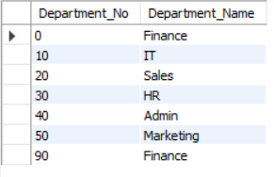
Request 10
List the department number and name for all departments where no programmers work.
Query
SELECT DISTINCT(Department_No), Department_Name FROM EMPLOYEE WHERE Job_Title != "Programmer" ORDER BY Department_No;
Output
Note : Here IT Department is Showing B’coz in IT there is a job title called ‘Support Assistant’.

Slide 15
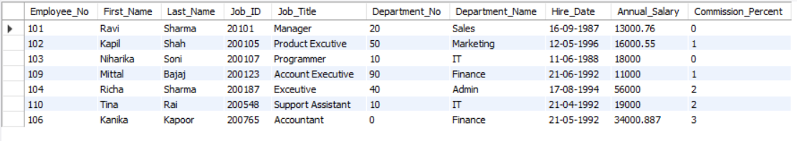
Request 11
List all the data for jobs sorted in ascending order of job id.
Query
SELECT * FROM EMPLOYEE GROUP BY Job_Title ORDER BY Job_ID;
Output

Slide 16
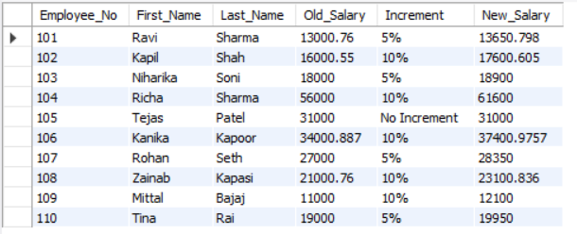
Request 12
Prepare a table with percentage raises, employee numbers and old and new salaries.Employees in departments 20 and 10 are given a 5% rise, employees in departments 50, 90and 30 are given a 10% rise and employees in other departments are not given a rise.
Query
CREATE TABLE Updated_Employee_Info As SELECT Employee_No,First_Name,Last_Name,Annual_Salary as Old_Salary,
CASE
WHEN Department_No=10 OR Department_No=20 THEN "5%“
WHEN Department_No=30 or Department_No=50 OR Department_No=90 THEN "10%“
ELSE "No Increment“
END AS Increment,
CASE
WHEN Department_No=10 OR Department_No=20 THEN (Annual_Salary+Annual_Salary*0.05)
WHEN Department_No-30 or Department_No=50 OR Department_No=90 THEN (Annual_Salary+Annual_Salary*0.10)
ELSE Annual_Salary
END AS New_Salary FROM EMPLOYEE;
SELECT * FROM Updated_Employee_Info;
Output

Slide 17
IT Manager Requirements
Request 13
Create a new view for manager’s details only using all the fields from the employee table. Show all the fields and all the managers using the view for managers sorted in ascendingorder of employee number.
Query
CREATE VIEW Manager_Info ASSELECT * FROM EMPLOYEE Where Job_Title="Manager";
SELECT * FROM Manager_Info ORDER BY Employee_No;
Output

Slide 18
Thank you
Purvang Majevadiya
Linked-In : https://www.linkedin.com/in/purvang-majevadiya
GitHUb : https://github.com/purvang2307

